Slide 1
Wednesday, November 7, 2012
Agenda:
TISK & MM
Lesson 5-4: Midsegments
Homework: 5-4 Worksheet
TISK Problems
Simplify: $\frac{6}{\sqrt{14}}$
Simplify: $−{(4x−6)}^{2}$
We will have 2 Mental Math Questions today.
Notes:
Mental Math
1.) Start with the product of 8 and -5. Add 15. Take the negative square root. Decrease by 12. (-7)
2.) Start with the product of the square root of 81 and the negative square root of 49. Divide by 3. Add 25. (4)

Slide 2
§5.4 Midsegment Theorem
Def.: A segment is a midsegment of a triangle if and only if it connects two midpoints of sides of the triangle.
Midsegments

Slide 3
Midsegment Theorem
What are some things we might be able to prove about midsegments?
Notes:
Let A(0, 0), B(2a, 2b) and C(2c,0). Find D and E. Find slope of DE and CB.

Slide 4
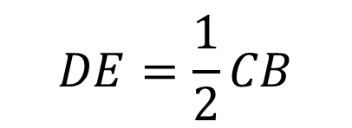
Midsegment Theorem
The segment connecting the midpoints of two sides of a triangle is parallel to the third side and half as long.
C
$$\overline{DE}∥\overline{CB}$$
D
$$DE=\frac{1}{2}CB$$
A
B
E

Slide 5
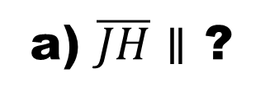
$\overline{GH}, \overline{HJ}, and \overline{JG}$are midsegments of $ΔDEF$
24
J
D
E
a) $\overline{JH}∥$ ?
8
10.6
b) $\overline{DE}∥$ ?
G
H
c) $EF=$ ?
d) $GH=$ ?
F
e) $DF=$ ?
f) $JH=$ ?
g) Perimeter of $ΔGHJ=$ ?

Slide 6
Verify that $\overline{AB}$ is the midsegment of $ΔQRO$.
Q
B(6,6)
A(1,4)
R(10,4)
O(0,0)

